Slide 1
Chapter 8
Digital Communication

Slide 2
Table of Contents
Introduction
Microcontroller Architecture
Software Development Platforms
Digital Input and Output
Interrupts and Power Management
Timing Operations
Conversion Between Analog and Digital Values
Digital Communication
Memory Operations
Real-time Operating Systems
LCD, Touch Screen, and Graphical User Interface Formation
Introduction to Digital Signal Processing
Introduction to Digital Control
Introduction to Digital Image Processing
Advanced Topics

Slide 3
LAYOUT
Background on Digital Communication
  Data, Frame, and Field
  Serial and Parallel Data Transfer
  Synchronous and Asynchronous Data Transfer
  Signal Representation and Line Formations
  Data Encoding Types
  Simplex, Half and Full Duplex Communication
  Master and Slave Modes
  Baud Rate
Universal Asynchronous Receiver Transmitter
  UART Working Principles
  UART Modules in the STM32F4 Microcontroller
Serial Peripheral Interface
  SPI Working Principles
  SPI Modules in the STM32F4 Microcontroller
Inter Integrated Circuit
  I2C Working Principles
  I2C Modules in the STM32F4 Microcontroller
Controller Area Network
  CAN Working Principles
  CAN Modules in the STM32F4 Microcontroller
Universal Serial Bus
  USB Working Principles
  USB Modules in the STM32F4 Microcontroller
Other Digital Communication Types
  SD Bus Interface
  Inter-IC Sound

Slide 4
Introduction
Digital communication handles operations to transfer data between a transmitter and receiver(s).
  The transmitter is the device sending data.
  The receiver is the device receiving data.
  The transmitter and receiver can
We will start with fundamental definitions.
Then, we will handle the most important digital communication types as
  UART
  SPI
  I2C
  CAN
  USB
We will also introduce other digital communication types as
  secure digital input and output
  inter-IC sound

Slide 5
Background on Digital Communication
Data, the message to be transmitted. This can be one byte or one kilobyte.
Due to the used communication type, we may not be able to transmit data at once. Hence, it should be segmented. Each segment will be called data chunk.
We can call the structure, containing data and other supplementary bits, transmitted to the receiver as frame also called packet.
Bits and bytes within one frame are grouped. We call each group as field.

Slide 6
Background on Digital Communication
Generic example explaining data and related concepts.

Slide 7
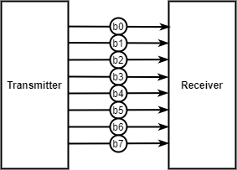

Background on Digital Communication
Serial and Parallel Data Transfer
There are two different data transfer types as parallel and serial.
Parallel data transfer
  used to achieve high transfer speeds.
  it requires several pins to operate.
Serial data transfer
  it only needs one or two pins.
  it is slow since data should be transmitted sequentially.
Serial data transfer
Parallel data transfer

Slide 8
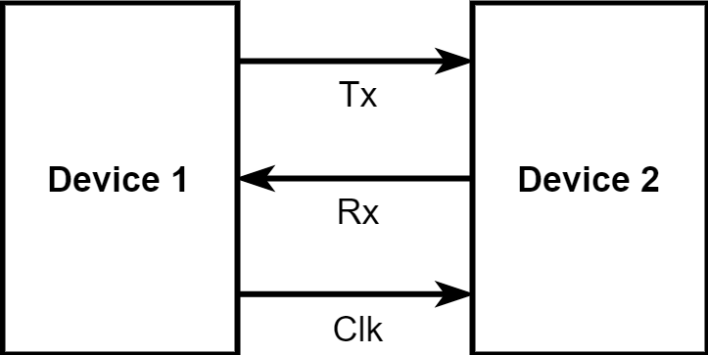
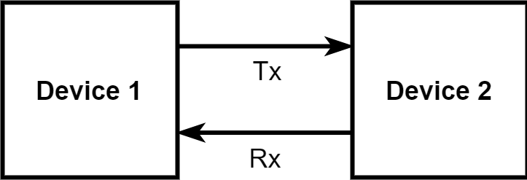
Background on Digital Communication
Synchronous and Asynchronous Data Transfer
Data transfer in digital communication can be synchronous or asynchronous.
Synchronous data transfer
  the transmitter and receiver is synchronized by a common clock signal.
  This synchronization signal can be sent along with data.
The asynchronous data transfer
  does not need such a synchronization signal.
  Start and stop bits for each data packet are sent.
  the transmitter and receiver should know and agree upon the transfer speed beforehand.
Synchronous data transfer
Asynchronous data transfer

Slide 9
Background on Digital Communication
Signal Representation and Line Formations
We also represent signals to be transmitted or received as voltage levels in digital communication.
There are two different line formations called
  single ended
  differential
The transferred signal is represented as a changing voltage value wrt ground in the single ended line.
  It requires less number of wires and less complex circuitry.
  Transferred signal is affected by the noise and line length in long range.
Two different lines are used in the differential line formation. The transferred signal is represented by the difference of two opposite voltage values in these lines.
  It is not affected much by the noise or range as in single ended line.
  There is a need for extra line.

Slide 10
Background on Digital Communication
Data Encoding Types
Data encoding types for digital communication
  non return to zero
  return to zero
  non return to zero inverted
  return to zero inverted
  Manchester coding

Slide 11
Background on Digital Communication
Simplex, Half and Full Duplex Communication
There are three communication modes as
  simplex
  half duplex
  full duplex
The simplex mode has one way (unidirectional) communication.
In half duplex mode, two-way (bidirectional) communication is possible. Only one way communication can be done at once.
In full duplex mode, two-way (bidirectional) communication is possible. The two-way communication can be done at the same time.

Slide 12
Background on Digital Communication
Master and Slave Modes
During data transfer between two or more devices, one can act as master the other as slave.
The master device generally starts the communication, asks information from slave devices and controls them.
The master device is the one generating the clock signal in synchronous communication.
The slave device is the one responding to the master or acts in accordance with the master device commands.

Slide 13
Background on Digital Communication
Baud Rate
The baud rate indicates how many bits are transmitted in one second for digital systems having logic levels 0 and 1.
This also corresponds to the bit rate definition.
Both definitions indicate the speed of data transfer.
the higher the baud rate, the faster the communication.

Slide 14
Universal Asynchronous Receiver Transmitter
UART Working Principles
UART is generally preferred when fast data transfer speed is not needed.
Data transfer in UART can be done in frames.
Each frame is composed of the start bit, data, parity bit, and stop bit(s).
Data can be composed of seven, eight, or nine bits.
Start and stop bits are available in each frame.
The parity bit can be used if needed.
UART uses NRZ data encoding.
UART can work in either full duplex, half duplex, or simplex modes.
The master and slave definitions do not apply to UART.
There is no theoretical limit for the baud rate in UART.
However, a limit applies based on the used microcontroller and its associated clock.

Slide 15
Universal Asynchronous Receiver Transmitter
General setup for UART communication between two devices
USART/UART block diagram in the STM32F4 microcontroller

Slide 16
Serial Peripheral Interface
SPI Working Principles
SPI is generally used for high=speed serial data transfer.
SPI has an 8- or 16-bit frame consisting only data.
Hence, no start, stop, or parity bits are used in the frame.
SPI uses NRZ data encoding.
SPI can work in half or full duplex mode.
SPI can work in either master or slave mode based on the application.
There is no limit for data transmission speed in SPI. As in UART, baud rate directly depends on the microcontroller and its clock used in operation.

Slide 17
Serial Peripheral Interface
SPI connection diagram between the transmitter and receiver
Block diagram of the SPI module in the STM32F4 microcontroller

Slide 18
Inter Integrated Circuit
I2C Working Principles
I2C has a frame structure with start, address byte, ack, data, and stop fields.
I2C uses NRZ for data encoding.
I2C works in half duplex mode. I2C has both the master and slave modes.
I2C has standard and fast data transfer modes.
A generic I2C frame

Slide 19
Inter Integrated Circuit
I2C connection diagram between master and slave devices
Block diagram of an I2C module in the STM32F4 microcontroller

Slide 20
Controller Area Network
CAN Working Principles
CAN has five frames called data, extended data, remote, error, and overload.
Data encoding used in CAN is NRZ with one difference. Since 0 V corresponds to logic level 1 and a voltage value higher than 1.5 V represents logic level 0 in CAN, logic levels are inverted.
There are two separate usages of half and full duplex modes in CAN.
  Data transfer between the microcontroller and transceiver is in full duplex mode.
  The CAN bus itself uses half duplex mode in communication.
The master slave option is not applicable to CAN bus. Instead there are specific protocols called CSMA/CD for this purpose.
The CAN bus does not carry a common clock signal. Hence, it is asynchronous.
The ISO-11898 standard specifies that the CAN bus transceiver should be able to drive a 40 m bus at 1 Mbits/s.

Slide 21
Controller Area Network
Generic CAN modules and CAN bus connection diagram
Block diagram of the bxCAN module in the STM32F4 microcontroller

Slide 22
Universal Serial Bus
USB Working Principles
Data in USB is represented in layers.
The highest layer is the frame.
There are transactions within a frame. These consist of packets.
Each packet is composed of fields.
In USB communication, one side should be master the other slave. However, the naming for these in USB terminology is host and peripheral (device), respectively.
Data transfer speeds in USB are set by standards and these can not be changed.
Besides, there are modes in USB versions (specific to USB 2.x and USB 1.x) as low speed (LS), full speed (FS), high speed (HS).

Slide 23
Universal Serial Bus
USB frame

Slide 24
Universal Serial Bus
USB connection diagram between the host and peripheral

Slide 25
Universal Serial Bus
Block diagram of USB modules in the STM32F4 microcontroller

Slide 26
Other Digital Communication Types
SD Bus Interface
SD bus is used to communicate with the SD card or other devices attached to the SD card slot.
SD bus interface is the communication type used for this purpose.
Secure digital input and output (SDIO) is the peripheral unit in the STM32F4 microcontroller performing SD bus interface operations.
Inter-IC Sound
Inter-IC sound (I2S) is extensively used for audio data transfer between ADC/DAC, codec integrated circuits (IC) and the microcontroller or DSP chips.
It has been introduced by Philips Semiconductors in 1986.
Then, it is revised in 1996.

